Slide 1
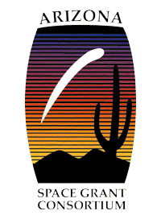



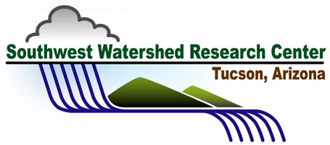
The Influence of Water Control Structures on Rangeland Vegetation Patterns
Lauren Thompson
Mentor: Mary Nichols, SWRC, USDA ARS
Virtual Symposium
4/18/20

Slide 2
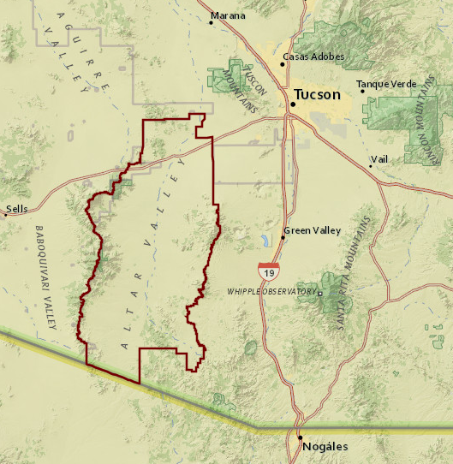
The Altar Valley
The Altar Valley is located southwest of Tucson, adjacent to the Baboquivari Mountains.
Spans about 45 miles from south to north
Stretches from Sasabe, AZ on the Mexico Border north towards the Tucson Mountains.
Figure 1. Map display of Altar Valley location. “GIS Portal,” Altar Valley Conservation Alliance, https://avca.maps.arcgis.com/apps/MapJournal/index.html

Slide 3
Statement of Problem
Until the late 1800s, the Altar Valley saw little human occupation due to limited water sources.
Once well-drilling and pumping technology became available, people began to migrate to the area and develop cattle ranches.
A common practice amongst cattle ranchers is the use of conservation structures, such as earthen berms, to control rangeland erosion and runoff.
These earthen structures alter runoff patterns creating areas of greater moisture upslope while drying other areas. If not maintained, the structures can cause channel incision and erosion.

Slide 4
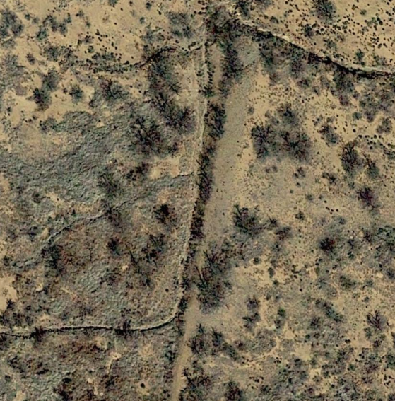
Our Objective
Runoff routed
around berm
To determine long-term effects of conservation structures on vegetation
The image shows a berm constructed to capture runoff on the upslope side.
There is a visible difference in the vegetation upslope in comparison to downslope, and runoff is now routed around the structure.
Upslope
Flow Direction
Downslope
Earthen Berm
Grass
Grass and Bare soil
Figure 2. A conservation structure and vegetation differentiation. Image retrieved from Google Earth.

Slide 5
Methods, Activities, and Analysis Techniques
Step 1 Classifications
Step 3 Boundary Selection
Step 4 Classification Distribution Measurements
Step 5 Distribution Data Analysis
Step 2 Accuracy Check
Classified vegetation and bare soil in orthographic imagery
Assessed user and system accuracy
Delineated upslope and downslope areas to quantify vegetation and bare soil
Quantified proportion of each class upslope and downslope of structures
To be done - statistical analyses to assess vegetation impacts of structures

Slide 6
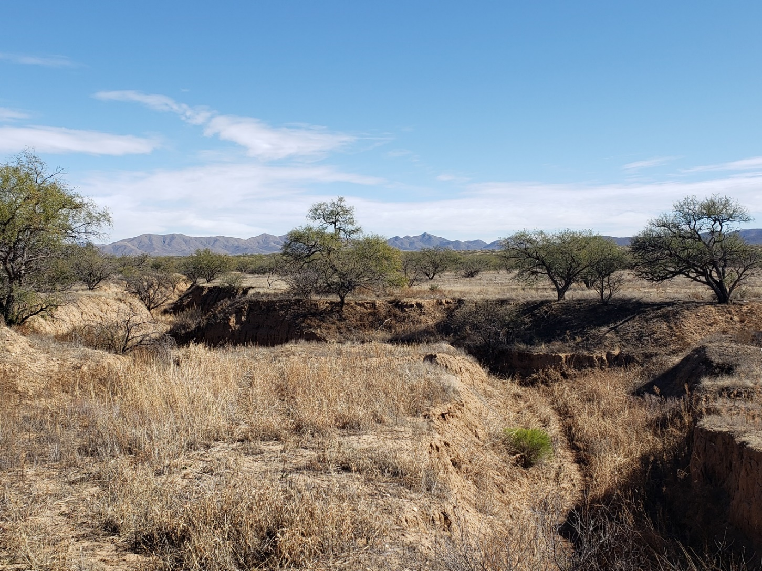
Results
Class Distributions Upslope vs. Downslope
The proportion of area covered by grass, shrubs and bare soil has been quantified for 116 structures at 3 sites within Altar Valley
Statistical analysis to compare the extent of coverage for each class upslope vs. downslope at each structure site is ongoing
Figure 5. Distribution of vegetation surrounding conservation structure in the Altar Valley

Slide 7
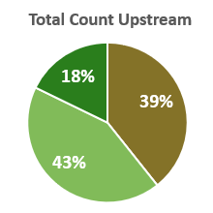
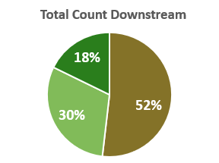
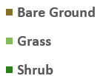
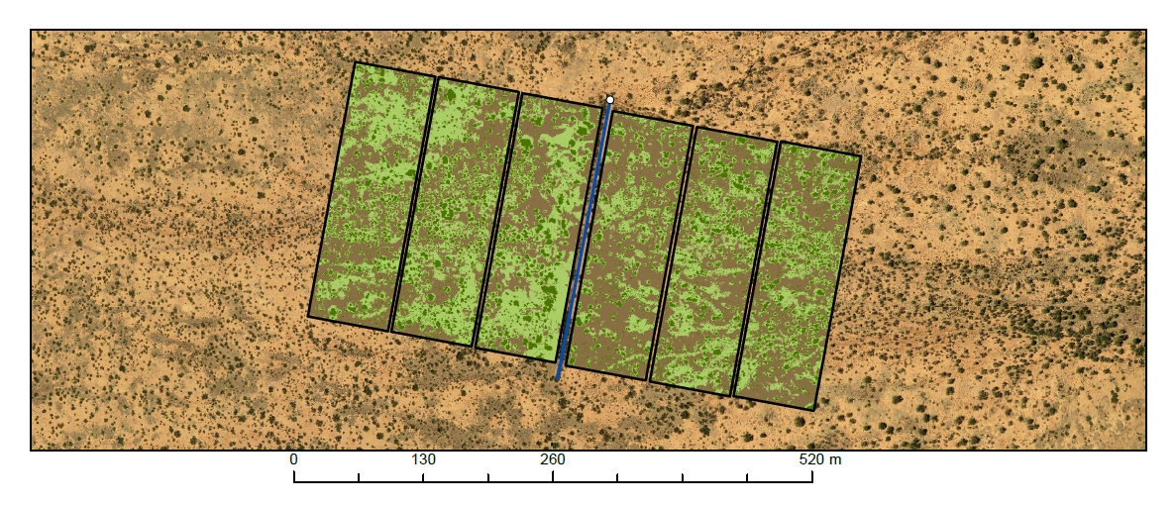
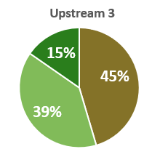
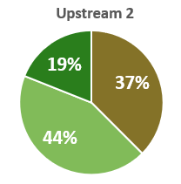
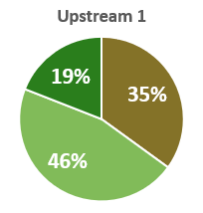
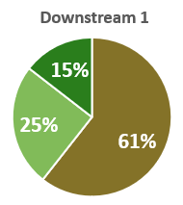
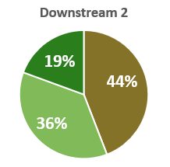
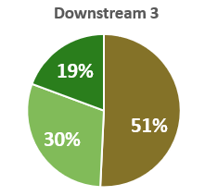
Results
Figure 4. Example of the spatial extent of grass, shrubs, and bare soil evaluated in ArcGIS Pro.
Earthen Berm
Upslope
Flow Direction
Downslope
3
2
1
1
2
3

Slide 8
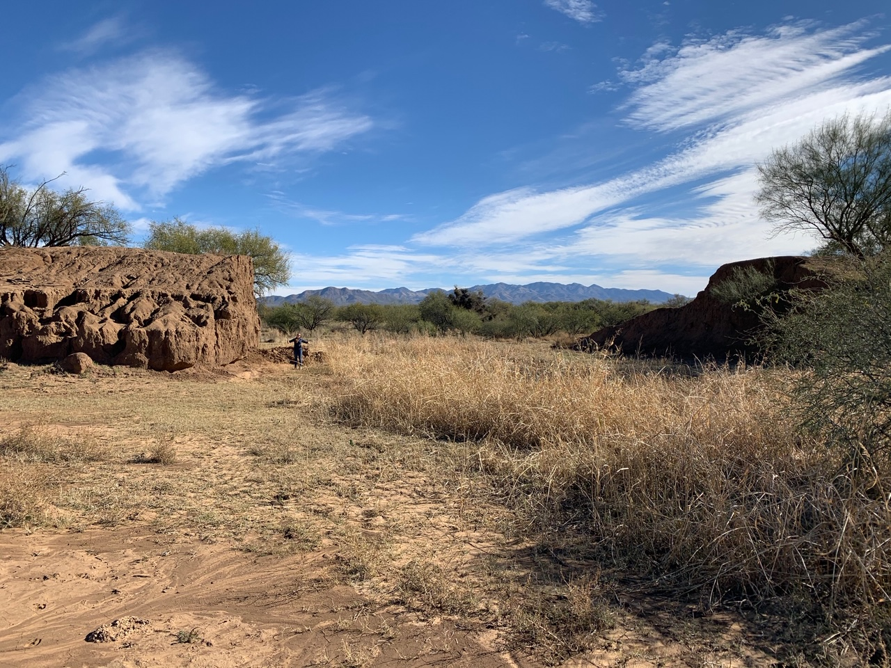
A New Perspective
A major drawback of using orthographic imagery is the inability to appreciate the scale in which the erosion is occurring.
To give a better perspective, this is me standing next to one of the structures that has been eroded. I am 5’3” which means this structure is at least three times my height!
Earthen berm
me
Figure 3. Image of a structure in the Altar Valley that has eroded.

Slide 9
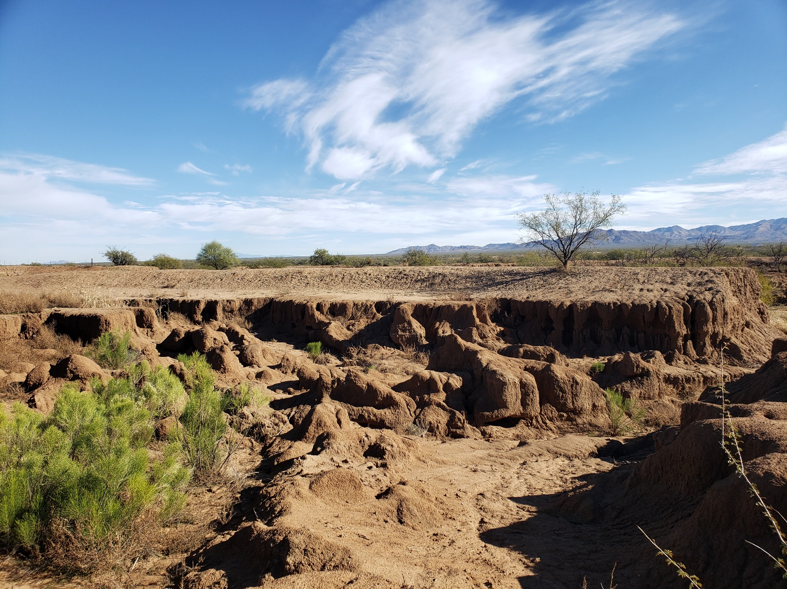
Significance and Impact
As runoff patterns are altered and soil is eroded, natural vegetation patterns are altered.
Knowledge of these changes is important for understanding the potential of vegetation restoration efforts that may be limited by altered runoff patterns.
Figure 6. Image of erosion and gullying in Altar Valley.

Slide 10
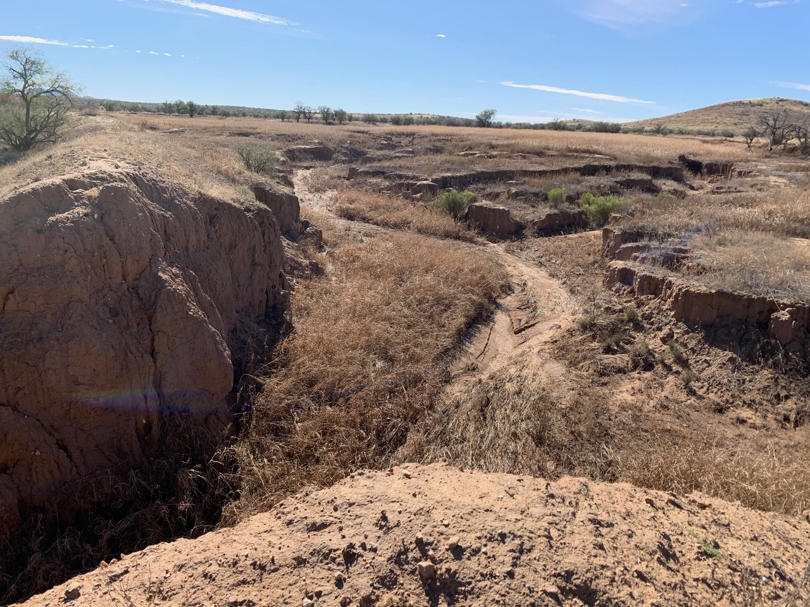
Significance and Impact
These structures should be regularly maintained, and failed structures should be repaired.
New structures can be built to prevent further gullying in areas that have been seriously affected.
This study is relevant to those who manage landscapes where runoff is altered by conservation structures.
Figure 7. Image of conservation structure in Altar Valley that has eroded.

Slide 11
Acknowledgments
Dr. Mary Nichols
Michelle Cavanaugh
Dr. Chandra Holifield Collins
UA NASA Space Grant Program

Slide 12
Thank You

